Slide 1
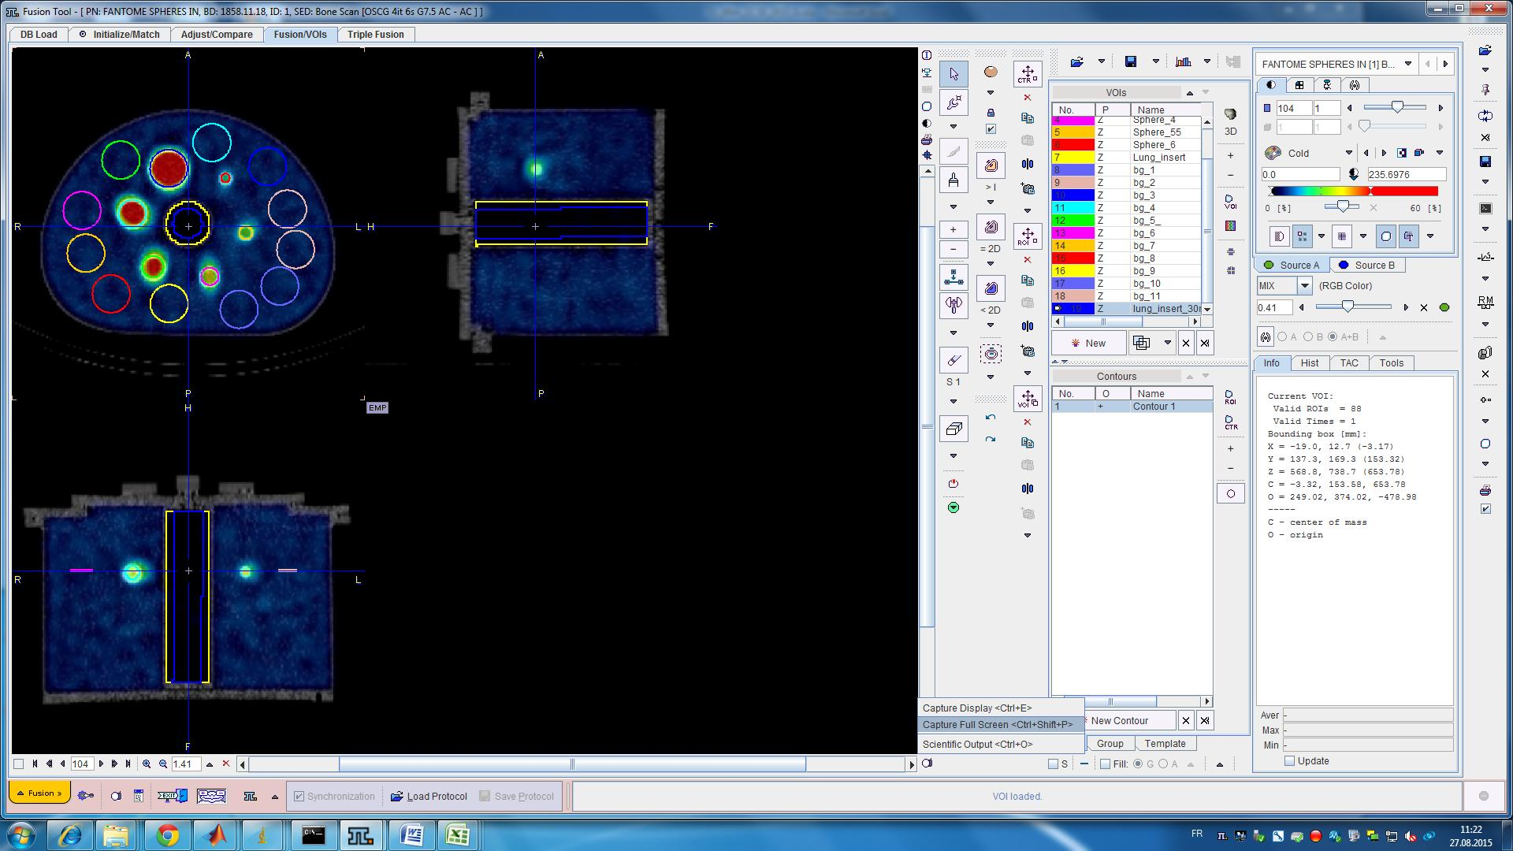
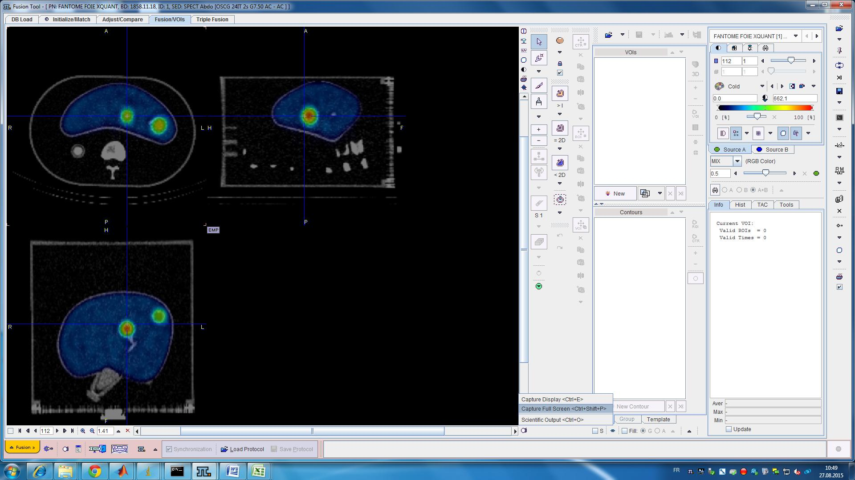
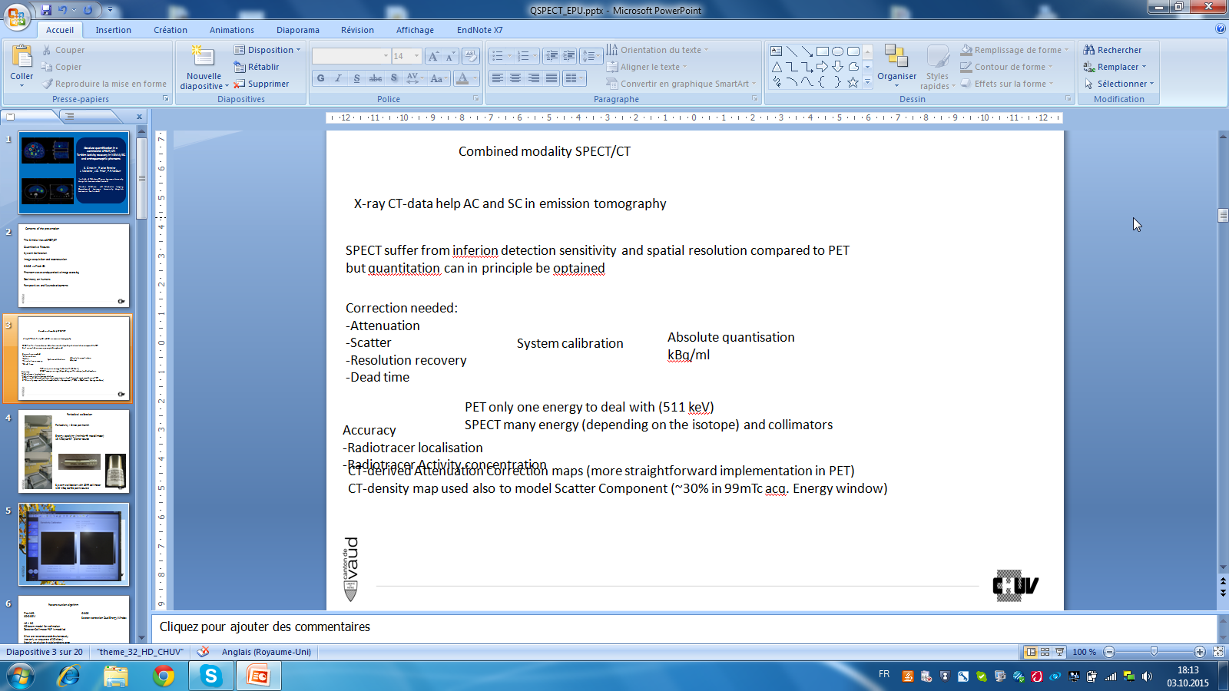
Quantification absolue dans l’évaluation de l’activité en imagerie SPECT/CT ^{99m}Tc sur une installation commerciale.
Validation sur fantômes.
S. Gnesin¹, P. Leite Ferreira²,
J. Malterre², J.O. Prior², F.R. Verdun¹
¹Institute of Radiation Physics, Lausanne University Hospital, Lausanne, Switzerland
²Nuclear Medicine and Molecular Imaging Department, Lausanne University Hospital, Lausanne, Switzerland
EPU «Méthodes de traitements d’images en Physique Médicale»7-9 Octobre 2015

Slide 2
Contents of the presentation
Quantitative SPECT vs. PET
The need for quantitative SPECT
The Symbia Intevo SPECT/CT
System Calibration
Results: quantitative image assessing on phantoms
Summary of main findings

Slide 3
Why absolute quantification in SPECT
SPECT joins PET in emission image quantification
SPECT suffer from inferior detection sensitivity and spatial resolution compared to PET
but quantitation can in principle be obtained
X-ray CT-data help AC and SC in emission tomography
CT-derived Attenuation Correction maps (more straightforward implementation in PET)
CT-density map used also to model Scatter Component (~30% in ^{99m}Tc acq. Energy window)
PET only one energy to deal with (511 keV)
SPECT many energy (depending on the isotope) and collimators
Accuracy
Radiotracer localisation
Radiotracer Activity concentration
Correction needed:
Attenuation
Scatter
Resolution recovery
Dead time
Absolute quantification
Bq/ml
System calibration

Slide 4
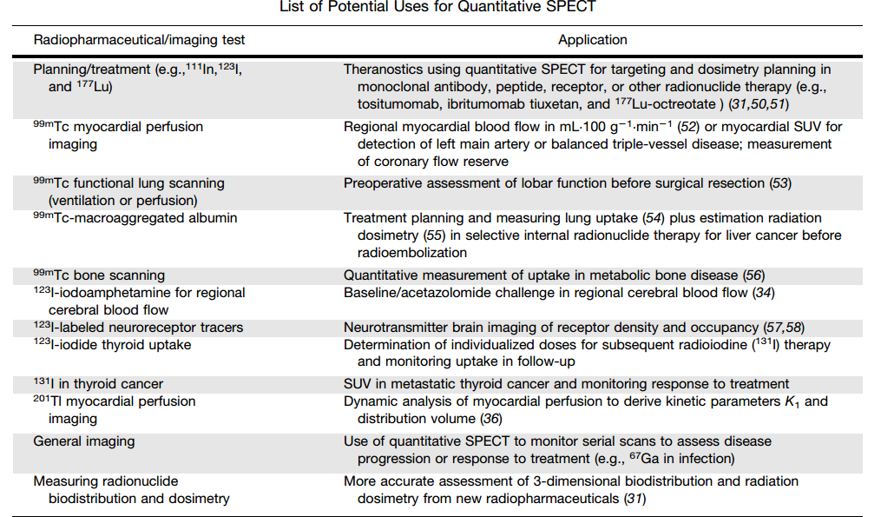
The Need for quantitative SPECT
Bq/ml
MBF/SUV
Bq/ml
SUV
Bq/ml / SUV
SUV
SUV
Bq/ml
An Evidence-Based Review of Quantitative SPECT Imaging and Potential Clinical Applications
Dale L. Bailey, and Kathy P. Willowson
J Nucl Med 2013; 54:83–89

Slide 5
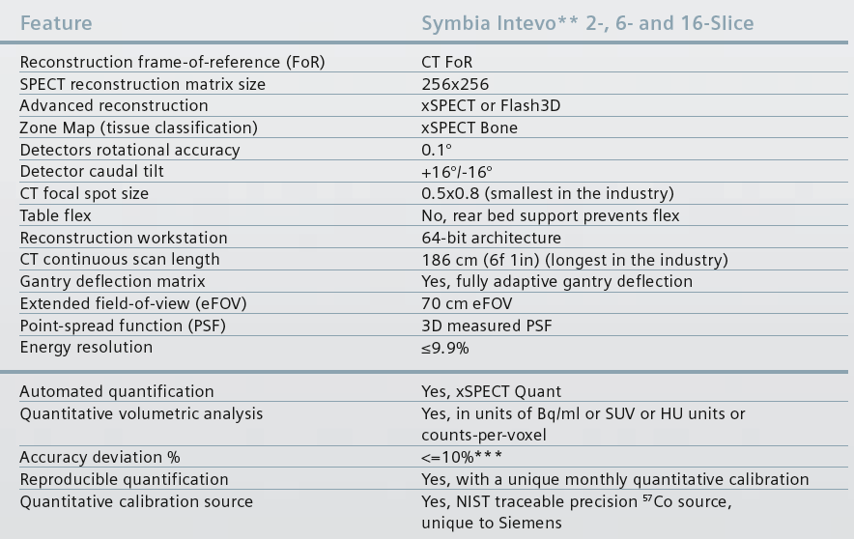
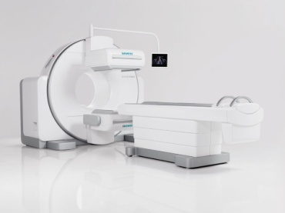
The SIEMENS Symbia Intevo SPECT/CT

Slide 6
SPECT image reconstruction
3D-OSEM (Flash3D)
Slice are reconstructed simultaneously
(not only a sequence of 2D slices)
Spatial resolution in axial and transverse
Plane are equal
AC CT-based att. Map
SC DEW or TEW
3D beam model for collimation
Detector-Collimator PSF is modelled
(UHR LEHR, MELP, HE ...)
Reconstruction matrix 128 x 128
(256 x 256 opt.)
3D Gaussian smoothing is applied
Trade-off noise vs. Resolution
Absolute quantification not available
Dicom Image Type: NM
OSCG quant (xSPECT quant)
Ordered Subset Conjugate Gradient
AC CT-based att. Map
SC DEW or TEW
3D beam model for collimation
Detector-Collimator PSF is measured
For the specific manufacturer LEHR with ^{99m}Tc
3D slice reconstruction in the CT Reference frame
Reconstruction matrix is 256 x 256 (128 x 128 opt.)
3D Gaussian smoothing is applied
Trade-off noise vs. Resolution
System specific Sensitivity calibration
(monthly) 57Co calibrated source
(99mTc is also possible)
Absolute quantification available (Bq/ml)
Dicom Image Type: PT

Slide 7
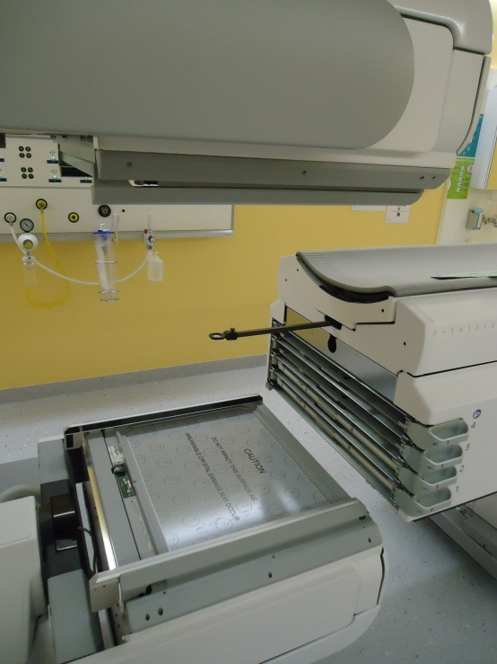
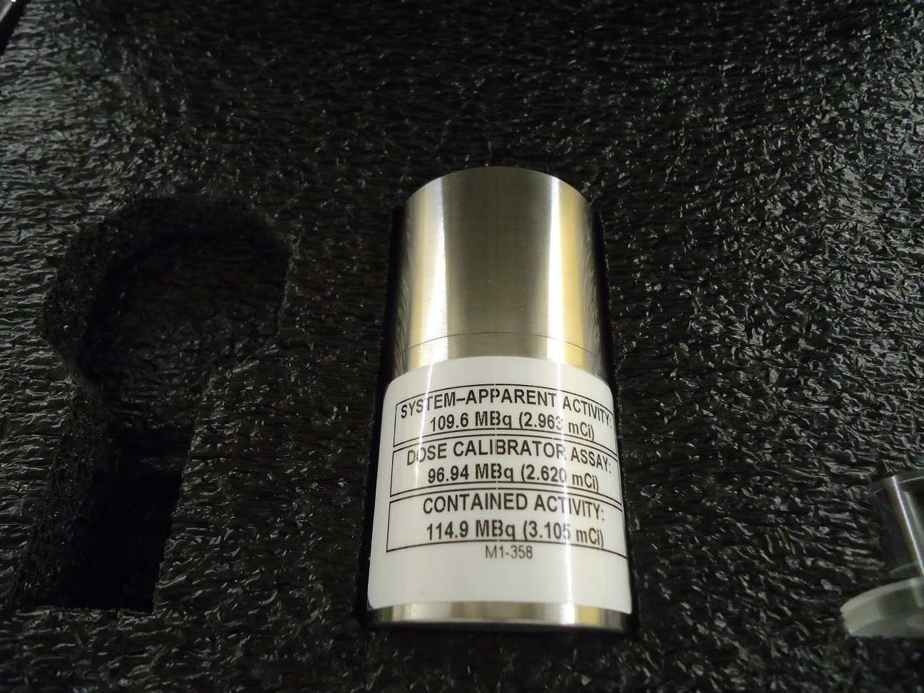
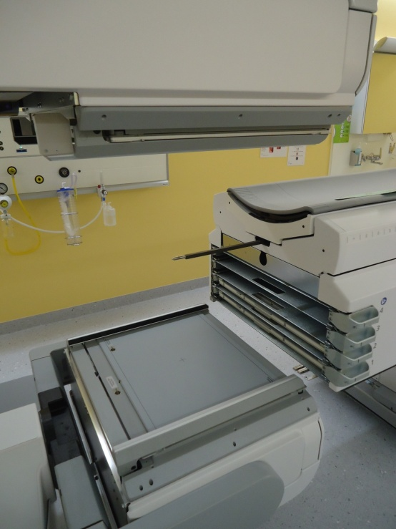
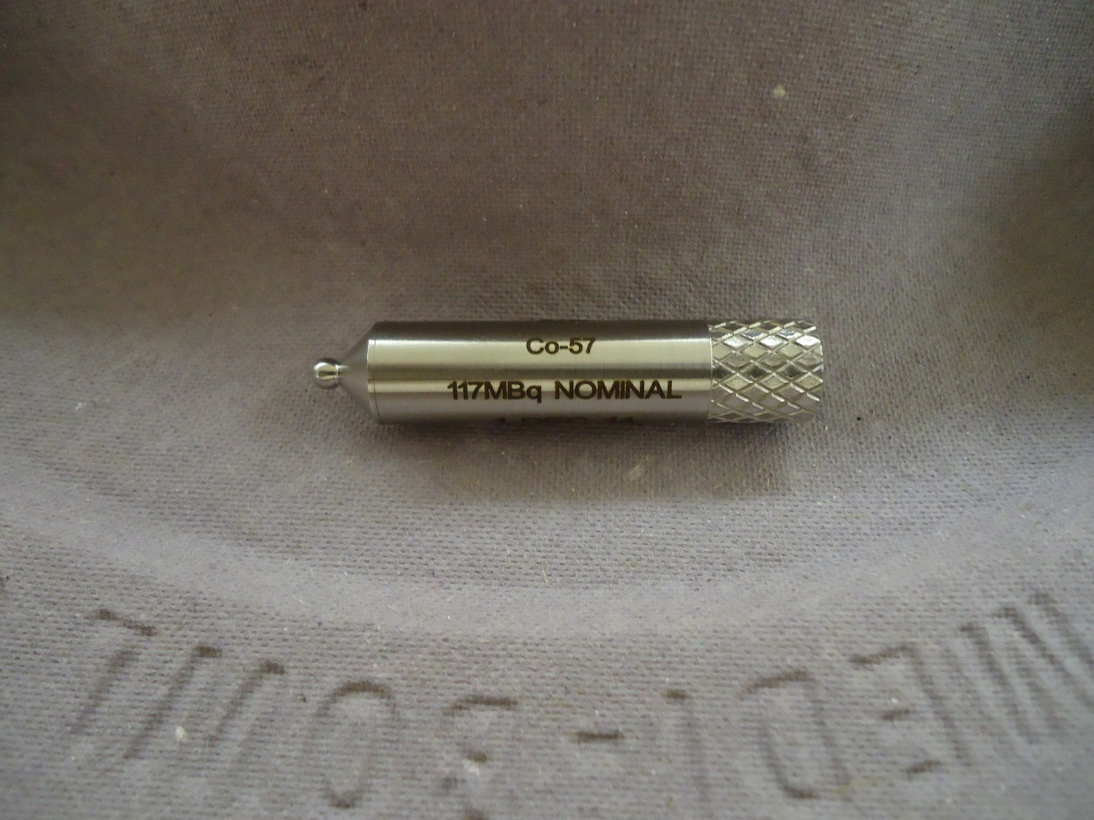
Periodical calibration
Periodicity : Once per month
Energy peaking (intrinsic → no collimator)
15 Mbq Co-57 planar source
System calibration with LEHR collimator
115 MBq Co-53 point source (NIST calibration source)

Slide 9
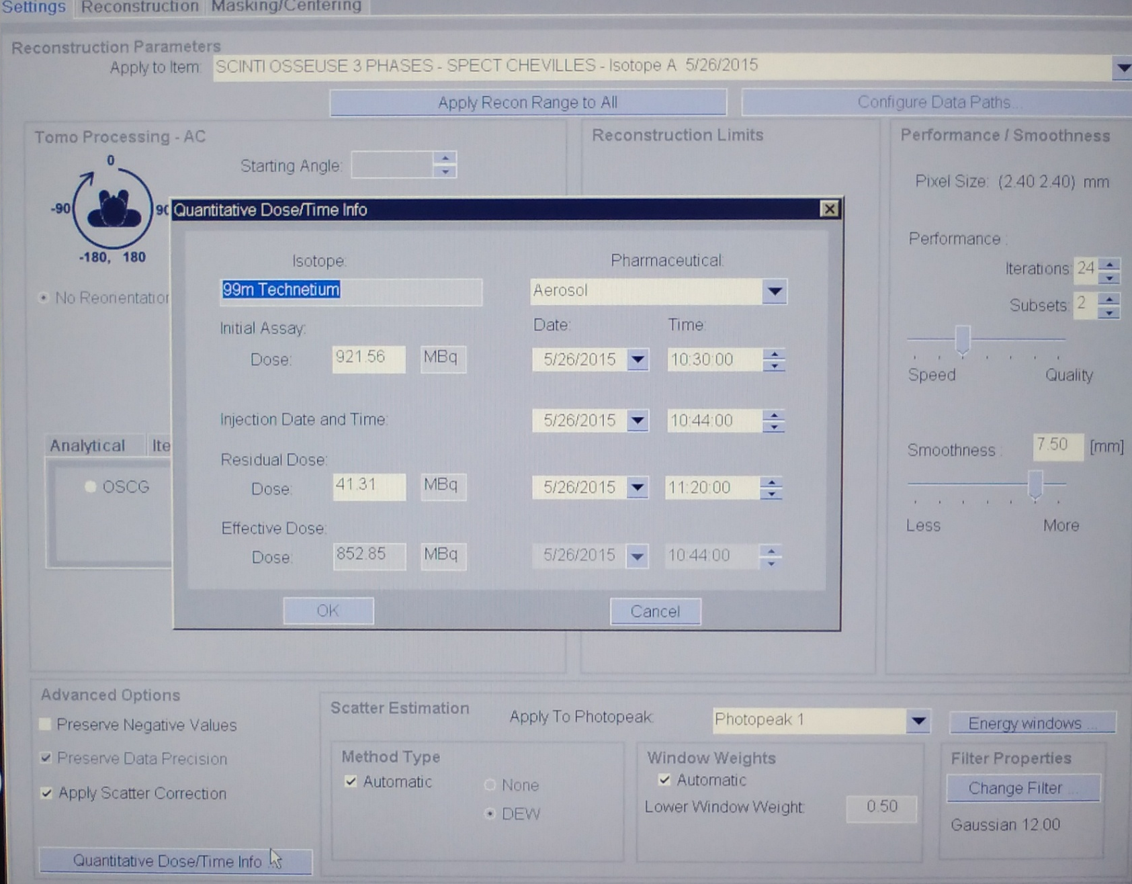

Slide 10
Activity decay correction
The PET point of view:
Decay Correction: START
T scan #1
T scan #2
T scan #N
...
T cal.
T admin.
A_{c,#1} = A_{c,Tscan1}
A_{c,#2} = A_{c,Tscan2}
A_{c,#N} = A_{c,TscanN}
The Intevo QSPECT point of view:
0054,1102 Decay Correction: ADMIN
...
T cal.
T admin.
T scan #1
A_{c,#1} = A_{c,Tadmin}
T scan #2
A_{c,#2} = A_{c,Tadmin}
T scan #N
A_{c,#N} = A_{c,Tadmin}
Voxel signal in terms of Activity concentration is decay corrected to the Administration time : DICOM Tag. Decay correction = ADMIN

Slide 11
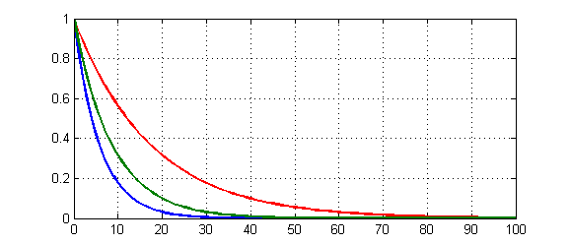
A(t)
Biological decay (accumulation/ washout)
A(t) = A(0)exp(-(ln2/Tb)t)
Tb = 12h (h)
Tp = 6.02 (h)
Physical decay
A(t) = A(0)exp(-(ln2/Tp)
Te = 4h (h)
Effective decay
A(t) = A(0)exp(-(ln2/Te)
t (h)
PET
Decay correction = START
QSPECT
Decay correction = ADMIN
For internal radiation dosimetry purposes
Typically compute the time integrated number of disintegration in a given VOI
(Area under the Te curve)
you need to rescale de QSPECT measured activity concentration at the actual scan time

Slide 12
Quantitative assessment in phantoms
Uniform phantom
Jaszczak phantom
NEMA NU-2 Phantom
Liver Phantom

Slide 13
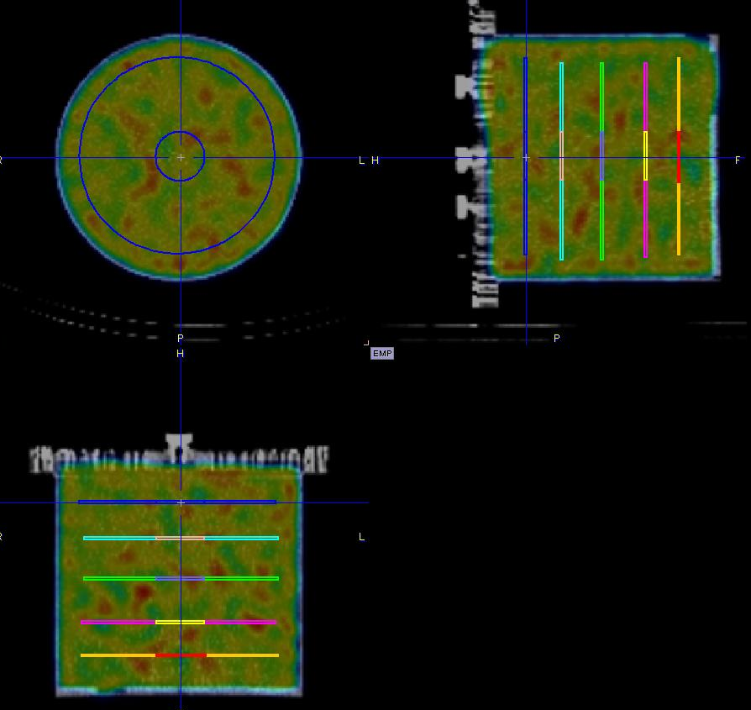
Cylindrical Homogeneous phantom
Acquisition with decreasing statistics
A c,bg 1 : 20 KBq/mL
A c,bg 4 : 2 KBq/mL
# acquisition | kBq/ml | Cal. | COV %
Ac bq 1 | 22 | 1.05 | 13
Ac bq 2 | 20 | 1.04 | 12
Ac bq 3 | 18 | 1.04 | 12
Ac bg 4 | 2 | 1.09 | 38
0008,0060 Modality: PT
0018,1210 Convolution Kernel: OSCGMM,24i,2s\Gauss,7.50mm
15% energy window
Typical QSPECT recon.
Energy window = 130-151 keV
FOV size = 256 x 256 (50 cm)
0028,0030 Pixel Spacing: 1.953126\1.953126
0018,0050 Slice Thickness: 1.953126

Slide 14
NEMA NU2 phantom
Hot spheres
Warm background
Lung insert
Lung error (%)
Hot contrast
Recovery coefficient

Slide 15
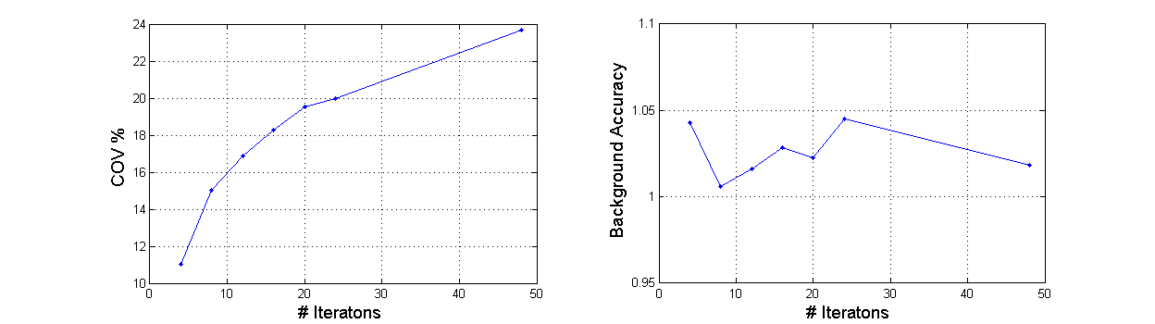
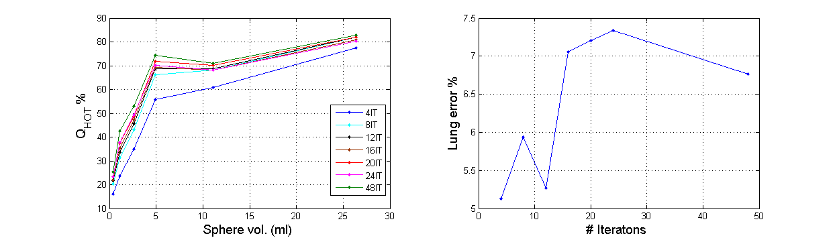
Reconstruction OSGC, [4 to 48] it, 2s; Gauss FWHM = 7.50mm
Ac,bg = 33 kBq/mL
Ac,spheres = 315 kBq/ml

Slide 16
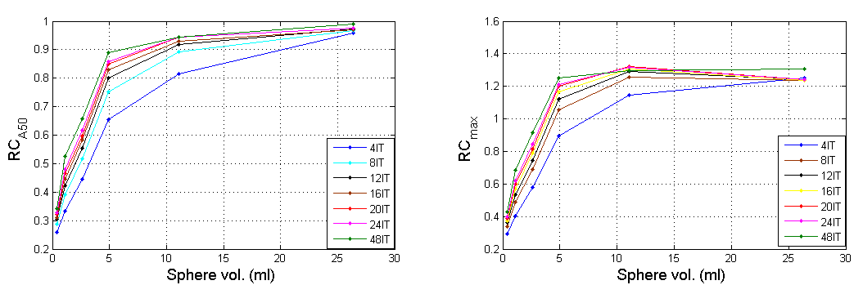
Recovery coefficients:
RC 50% adapted for background
RC max
Reconstruction OSGC, [4 to 48] it, 2s; Gauss FWHM = 7.50mm
Ac,bg = 33 kBq/mL
Ac,spheres = 315 kBq/ml

Slide 17
Quantitative accuracy as a function
of Background Activity concentration
 | Ac bg | Ac Spheres | Bg cal | COV % | ΔC lung % | QH & (22mm)
Admin | 25.38 | 214.65
Scan 1 | 23.27 | 196.87 | 1.06 | 20 | 5.78 | 65
Scan 2 | 18.30 | 154.82 | 1.03 | 24 | 5.70 | 67
Scan 3 | 12.32 | 104.20 | 0.98 | 28 | 7.79 | 65
Scan 4 | 1.46 | 12.36 | 1.01 | 55 | 20.47 | 65

Slide 18
La reconstruction SPECT Skeletal (xSPECT Bone)
- reference frame is the morphologic CT
SPECT reconstructions are ‘’driven’’ to the CT-measured electron density
on a 256 x 256 matrix-size
‘’contest based reconstruction’’
Application in ^{99m}Tc bone SPECT with Potential improvement in
skeletal activity localization
bone lesion contras
Absolute quantification available (Units: Bq/mL)

Slide 19
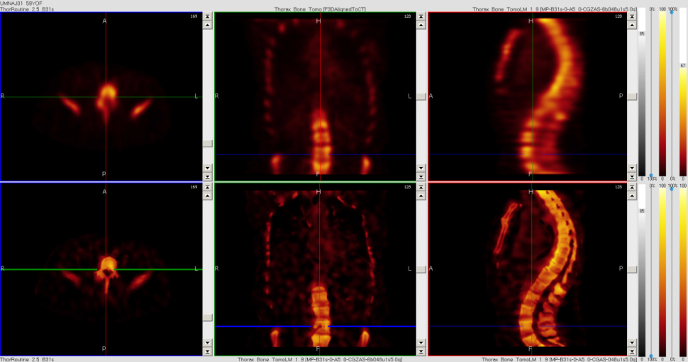
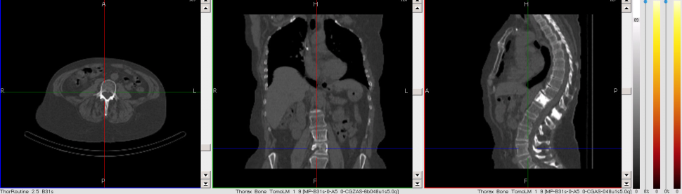
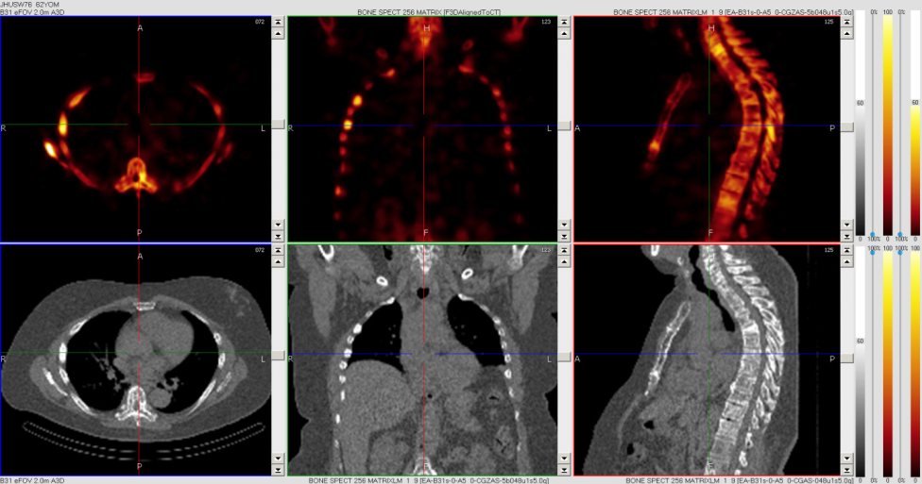
Top row: Flash3D reconstruction using attenuation and scatter correction.
Central row: Context based xSPECT Bone reconstruction of the same data.
Bottom row: CT image.
Top row: Context based reconstruction xSPECT Bone.
Bottom row: CT image.
Introduction to xSPECT* Technology: Evolving Multi-modal SPECT to Become Context-based and Quantitative
White Paper (SIEMENS)
(display from research workstation) Data courtesy of University of Minnesota, Minneapolis, Minnesota, USA.

Slide 20
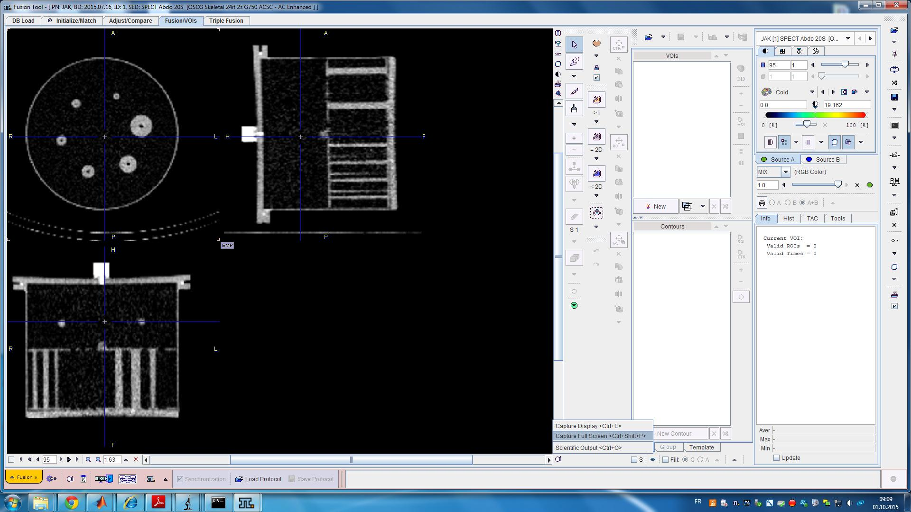
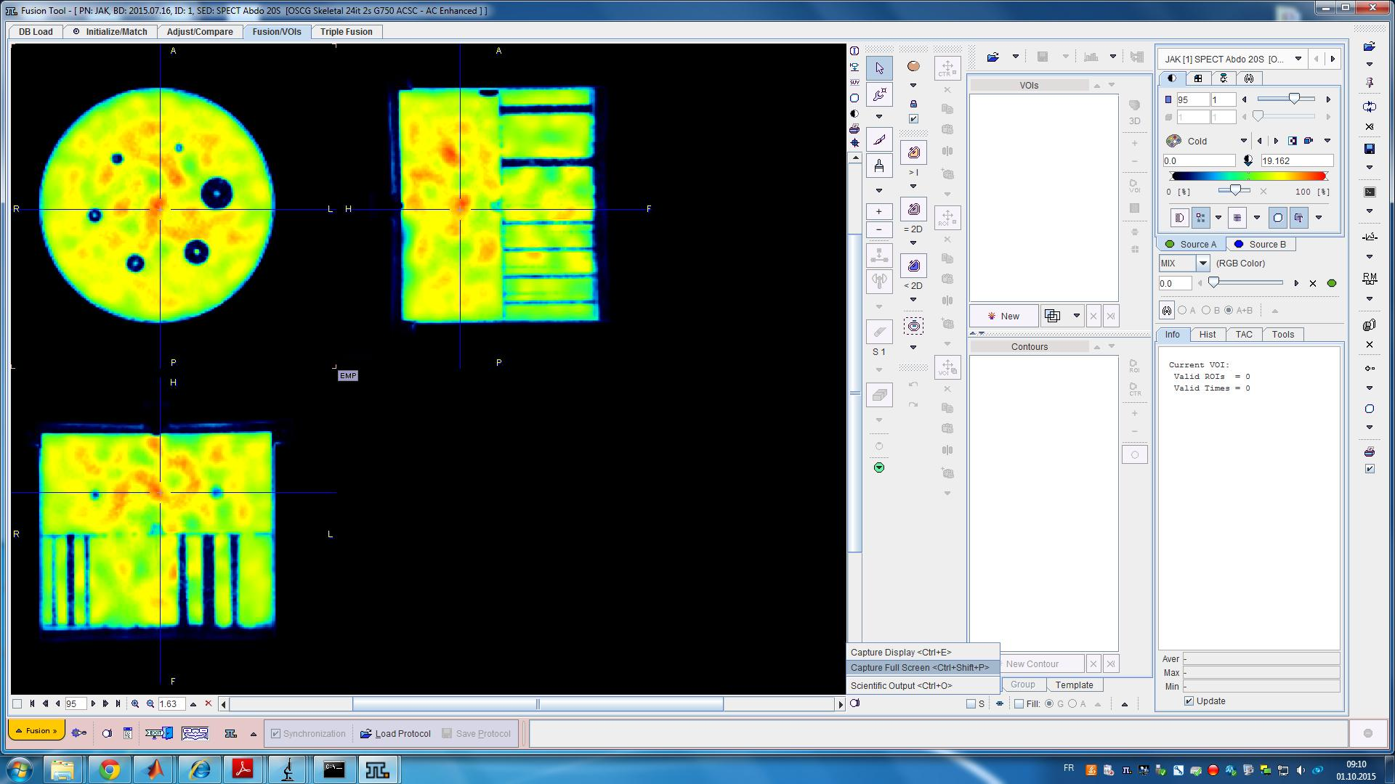
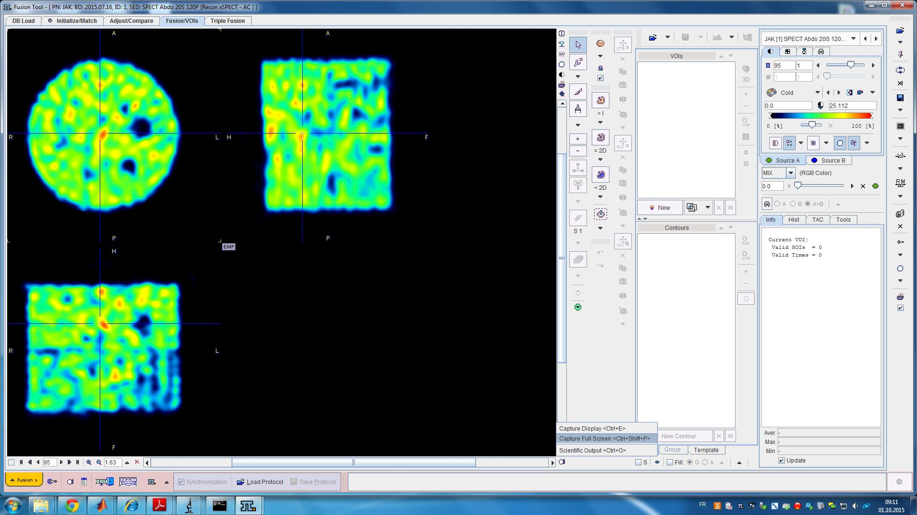
B
Jaszczak Phantom Deluxe
Ac = 10 kBq/ml
Acquisition SPECT
120 proj/20s LEHR
Reconstruction:
A: OSCG (xSPECT) quant
(24it/2s FWHM = 7.5 mm)
A
B: OSCG skeletal (xSPECT bone)
(24it/2s FWHM = 7.5 mm)

Slide 21
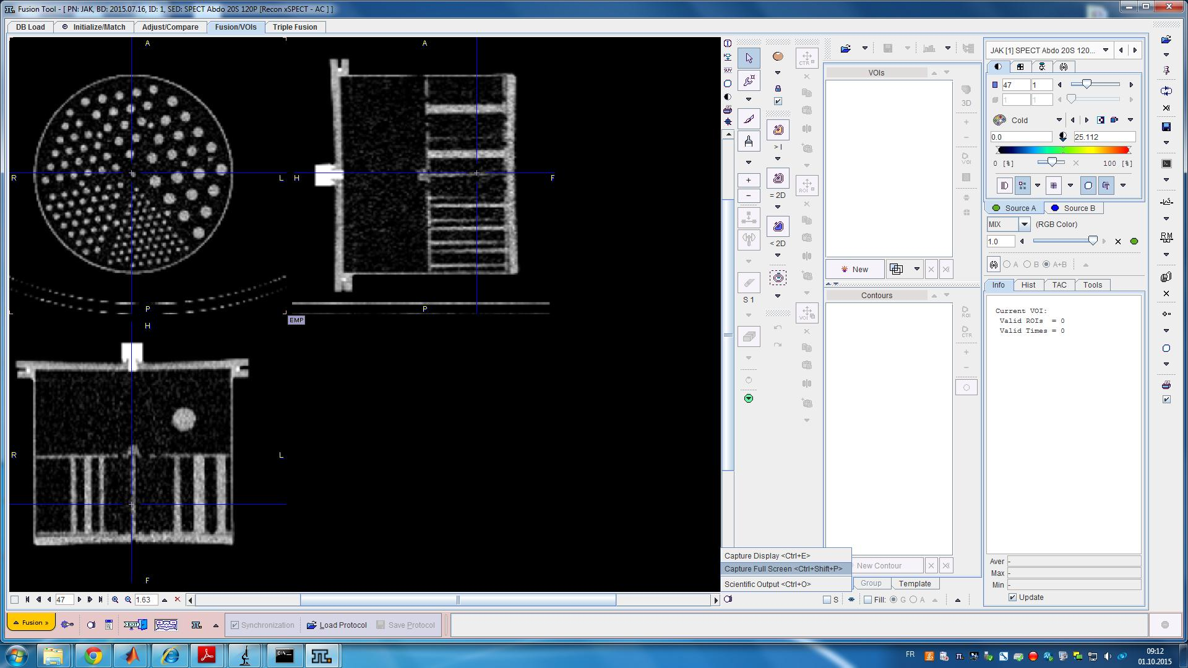
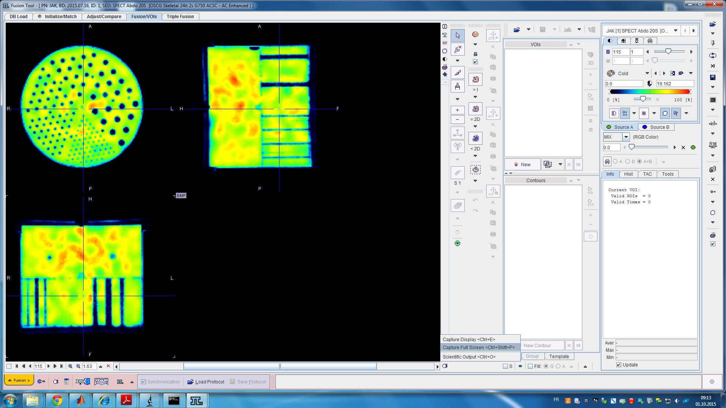
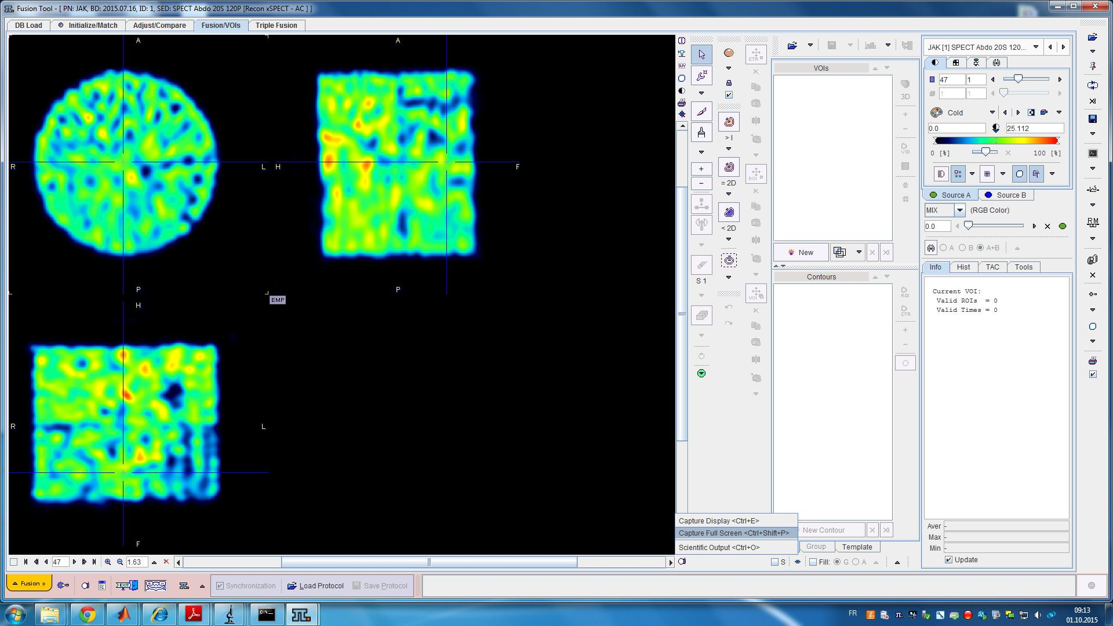
B
Jaszczak Phantom Deluxe
Ac = 10 kBq/ml
Acquisition SPECT
120 proj/20s LEHR
Reconstruction:
A: OSCG quant (24it/2s FWHM = 7.5 mm)
B: OSCG skeletal (24it/2s FWHM = 7.5 mm)
A

Slide 22
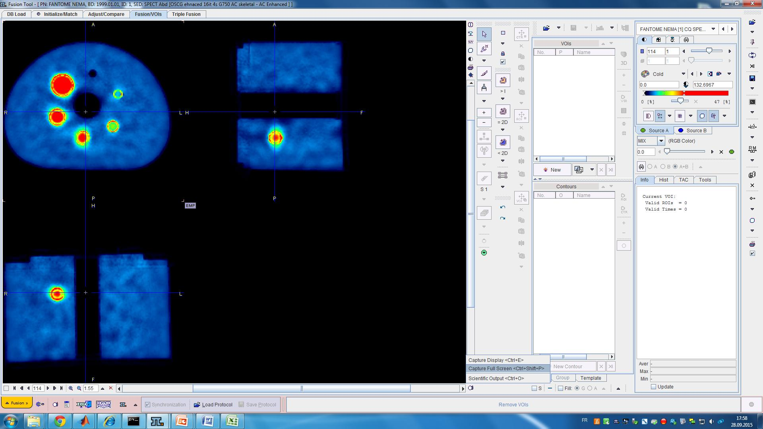
xSPECT quant vs. xSPECT bone in local activity recovery
Ring Artefact around hyper-dense structures
Signal removed from
cold regions;
Lung insert
Cold spheres
Diminished noise in a uniform background: COV 6% vs 20 % OSCG non skeletal)

Slide 23
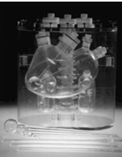
Anthropomorphic Liver Phantom
Liver insert volume: 1.8L
^{99m}Tc activity concentration: A_{c_bg} kBq/mL
Background cal. and noise (COV)
Three spherical lesions:
20, 30 and 40 mm diameter respectively
^{99m}Tc Activity concentration: A_{c_l} kBq/mL
Size dependents Recovery coefficients (RC)
Lesion/Liver Activity concentration ratio
A_{c_l}/A_{c_bg} = 5:1
Remaining phantom volume filled with water
(no activity)
Realistic Activity concentrations and activity ratio in SIRT
SPECT/CT Acquisition (SIEMENS Symbia Intevo)
Number of projections: 120 (60 steps x 2 detectors)
Acquisition time duration: 20s per projection
Reconstruction algorithms: OSCG ( 4 subsets),
Gaussian Smoothing FWHM = 7.5mm.
Impact of activity concentration : image quality and quantitative accuracy

Slide 24
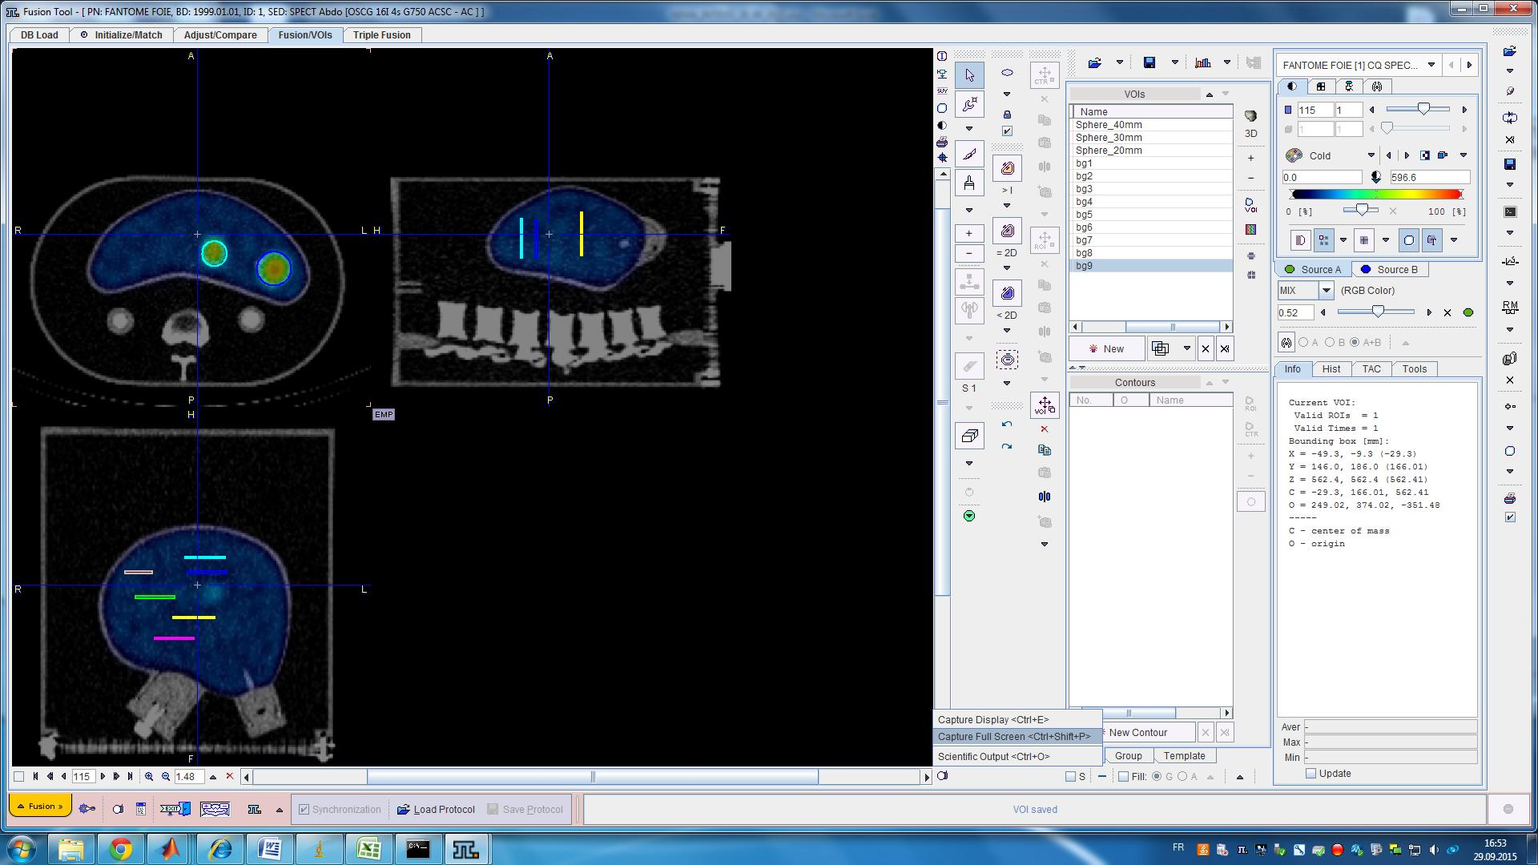
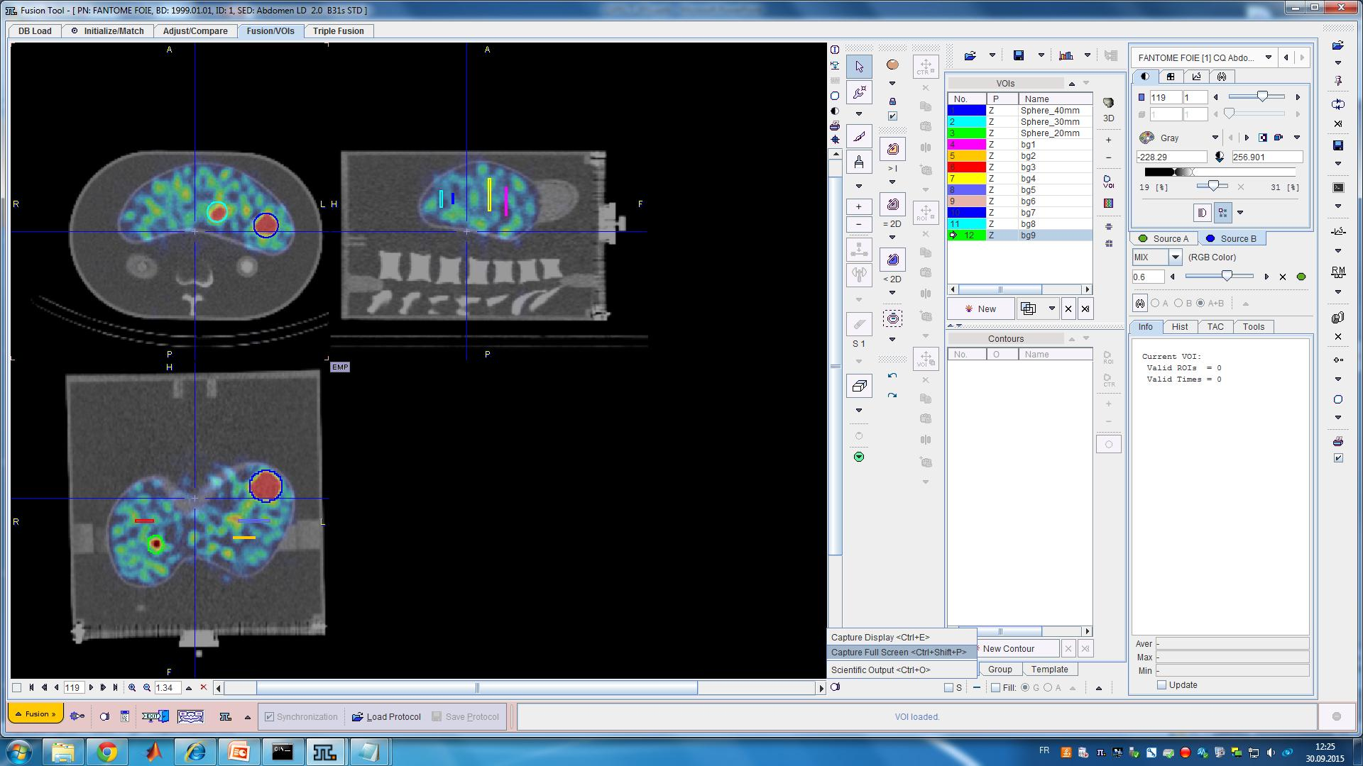
Liver Phantom
Hot sphere/Bg Activity ratio = 5.2:1
Acquisition parameters:
120 projections/20s
OSCG quantitative reconstruction
16 It; 4 subs.
Gaussian smoothing FWHM = 7.5mm
# scan | Ac b kBq/m | Ac Sph. kBq/ml | Bg cal | COV % | Q_{H} 40mm | Q_{H} 30mm | Q_{H} 20mm
Admin | 91.95 | 478.21
Scan 1 | 77.79 | 404.57 | 1.08 | 8.47 | 0.68 | 0.51 | 0.30
Scan 2 | 62.13 | 323.09 | 1.07 | 8.99 | 0.67 | 0.51 | 0.29
Scan 3 | 42.05 | 218.70 | 1.06 | 12.12 | 0.67 | 0.54 | 0.33
Scan 4 | 4.99 | 25.95 | 1.07 | 43.25 | 0.71 | 0.51 | 0.33
Scan 4
25h after Scan 1
Measured activity concentration exceed ~7% the expected one
Hot contrast do not vary significantly with activity concentration

Slide 25
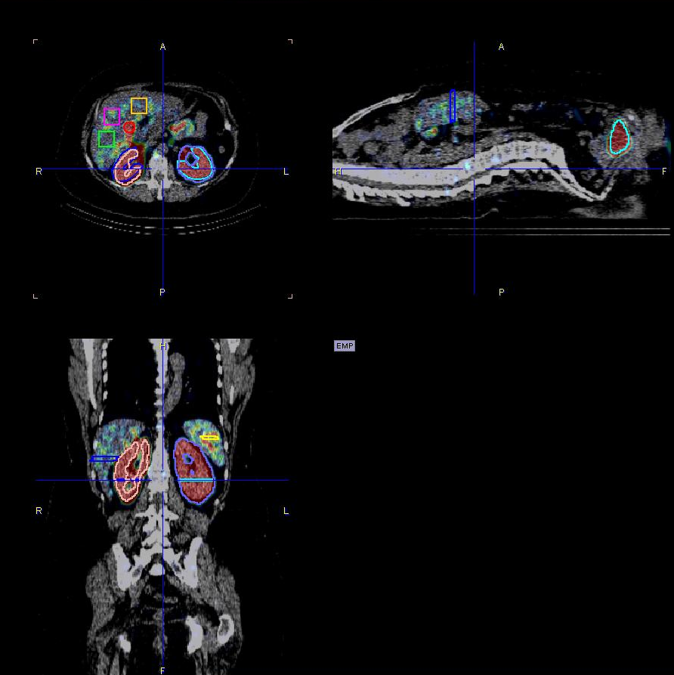
Example of SPECT quantification in Human
A admin = 209 MBq ^{99m}Tc-Traceur exp.
SPECT/CT 4h post-administration
OSCG 16it 4s FWHM = 7.5 mm
ROI
Ac (kBq/ml)
STD
Kidney Right | 52.7 | 15.3
Kxdney Left | 55.2 | 14.17
Liver_bg1 | 5.37 | 2.13
Liver_bg2 | 7.57 | 4.07
Liver_bg3 | 4.57 | 2.53
GallBladder | 48.58 | 13.7
Spleen VOI | 12.64 | 3.77
KL_VOI | 49.42 | 16.37
KR_VOI | 60.36 | 10.88
Liver_VOI | 6.82 | 4.23
Bladder_VOI | 94.75 | 27.44
For dosimetry purpose:
(kBq/ml) is evaluated at t = T _{admin}
It need to be rescaled to T _{scan}
To appropriately calculate total number
of disintegration in a given VOI
Then derive Residence times
and consequent organ dose

Slide 26
Summary of Main Findings
Similar to PET, ‘’ready to use’’ absolute quantitative image modality is becoming available in commercial SPECT/CT devices (Siemens Symbia Intevo)
On NEMA-NU2 phantom, ^{99m}Tc measured background activity concentration (AC_{bg}) was <6% from the expected true value for all tested cases
Relative lung error (~10%) was comparable to PET levels assessing the efficient integration of attenuation and scatter corrections with adequate detector/collimator modeling
Comparable AC_{bg} accuracy and recovery coefficient (RC) values were found for the anthropomorphic abdominal liver phantom
Reliable SPECT quantification (~10% accuracy) has the potential to improve clinical outcome and radiation dosimetry assessments
Reconstruction parameters influence RC (and thus SUV), and optimization is recommended in accordance with clinical requirements
Present limitation to ^{99m}Tc/LEHR SPECT
Future extension to other radioisotope/collimator is welcome

Slide 27
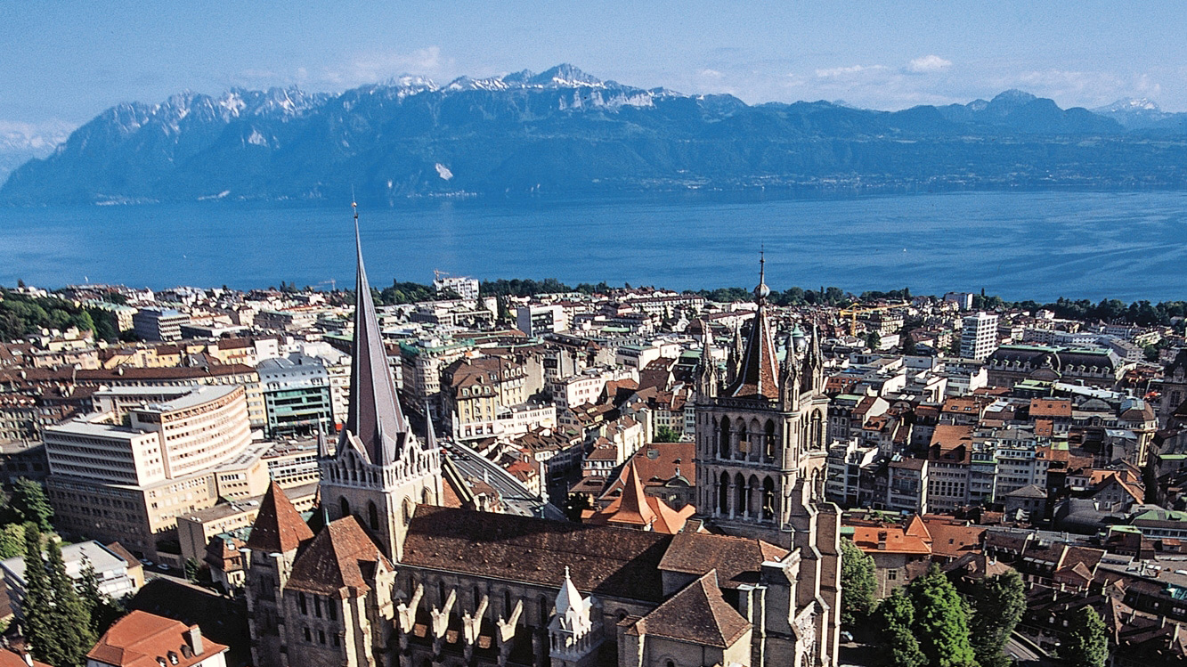
Merci pour votre attention

